Slide 1
Recruitment and Engagement of Diverse Populations
Jasmine Bell, MPH, Recruitment Innovation Center, Vanderbilt University Medical Center
Sheila V. Kusnoor, PhD, Center for Knowledge Management, Vanderbilt University Medical Center
Trial Innovation Network Open Forum Session
July 15, 2021

Slide 2
Overall approaches to recruiting diverse populations
Jasmine Bell, MPH
Recruitment Innovation Center
Vanderbilt University Medical Center

Slide 3
Goals
Provide background information for racial underrepresentation in clinical research
Explore origins of racial health disparities and how they are sustained
How to approach research through a health equity lens
Material strategies and recommendations for promoting racial diversity in research

Slide 4
Background

Slide 5
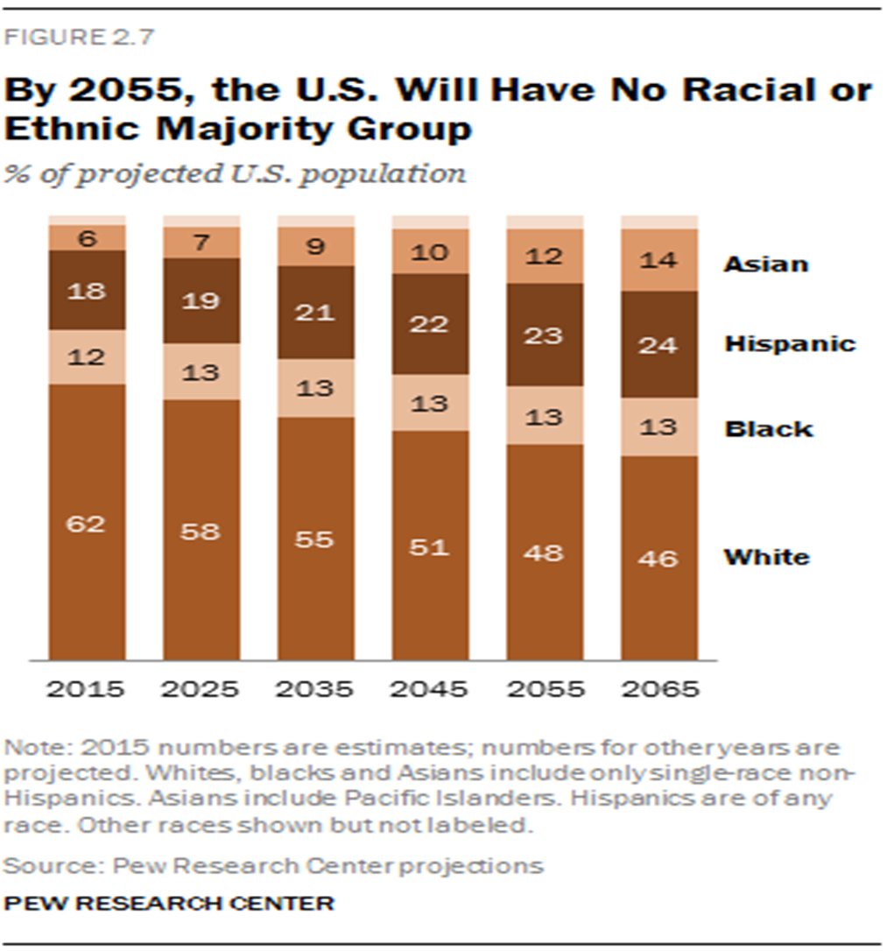
Anticipated changes to the racial majority by 2055
BACPAC
Notes:
In 2015, The Pew Research Center released a report that forecasted by the year 2055, the US population will NOT have a racial or ethnic majority group. Projections show Asian and Hispanic populations will continue to outpace Black and White racial groups in population growth. The US will increasingly reflect a more linguistically and culturally diverse population. As the population becomes more diverse, I hope in the future the question about diversity will be obsolete. However, in the present, what we will we do over the next couple, years or decades to ensure (a.) that every individual feels as though clinical trials provide a fair opportunity to be a part of medical discoveries, and (b.) that we increase transparency and trust in the healthcare system and the research process. If we can begin to answer these concerns, I hope it means that we are moving collectively into a space of intentional and meaningful inclusion of historically underrepresented groups in clinical trials.

Slide 6
Underrepresentation in clinical research
Black or African American individuals represent 13.4% of the population, yet the FDA reports show that only 5% of clinical trial participants come from this demographic.
Hispanic or Latino heritage individuals, represent almost one fifth (18.1%) of the population yet only 1% of trial participants.
It’s important to include diverse populations to understand the generalizability of study findings
Racially diverse populations often have a higher burden of disease
Diversity in Clinical Trials. (n.d.). Clinical Research Pathways. Retrieved July 8, 2021, from https://clinicalresearchpathways.org/diversity/

Slide 7
Racial health disparities
For women over the age of 30, pregnancy related mortality for black and AI/AN women was four to five times higher than it was for white women.
The risk of diabetes is 77% higher among African Americans than among non-Hispanic white Americans.
Last six months of life is $7,100 more expensive to the Medicare system for Black people, and $6,100 more expensive for Hispanics, compared with white people.
Health Inequality Actually Is a “Black and White Issue”, Research Says. (n.d.). Retrieved July 8, 2021, from https://healthblog.uofmhealth.org/lifestyle/health-inequality-actually-a-black-and-white-issue-research-says
Byhoff, E., Harris, J. A., Langa, K. M., & Iwashyna, T. J. (2016). Racial and Ethnic Differences in End-of-Life Medicare Expenditures. Journal of the American Geriatrics Society, 64(9), 1789–1797. https://doi.org/10.1111/jgs.14263

Slide 8
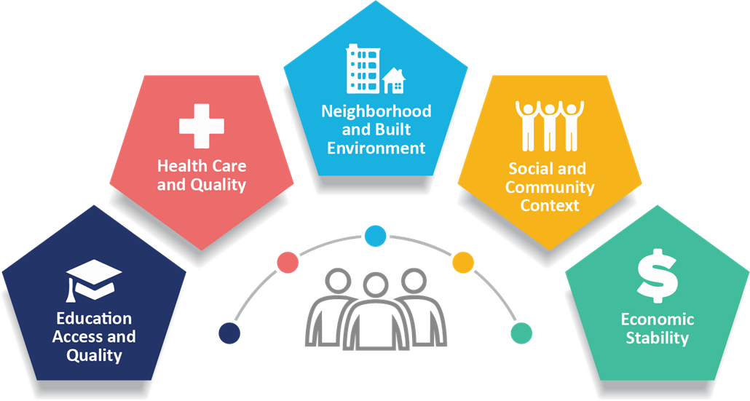
Origins of racial health disparities
Health disparities are preventable differences in the burden of disease, that are experienced by socially disadvantaged populations.
Social determinants of health and social factors are racialized and create racial disparities in health care
CDC. Community Health and Program Services (CHAPS): Health Disparities Among Racial/Ethnic Populations. Atlanta: U.S. Department of Health and Human Services; 2008

Slide 9
Overall Approaches and Strategies

Slide 10
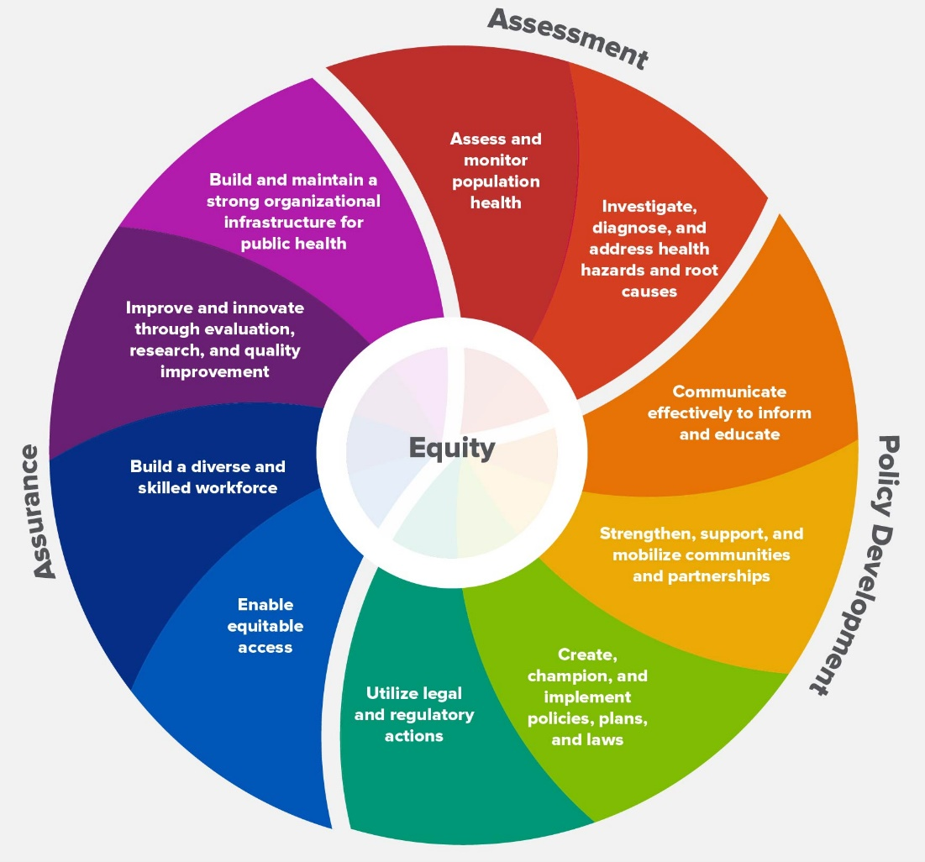
Applying a health equity lens in research
Construct study design and procedures through a health equity lens through:
Assurance
Assessment
Policy Development
CDC - 10 Essential Public Health Services—CSTLTS. (2021, March 18). https://www.cdc.gov/publichealthgateway/publichealthservices/essentialhealthservices.html
Notes:
Assess and monitor population health status, factors that influence health, and community needs and assets
Investigate, diagnose, and address health problems and hazards affecting the population
Communicate effectively to inform and educate people about health, factors that influence it, and how to improve it
Strengthen, support, and mobilize communities and partnerships to improve health
Create, champion, and implement policies, plans, and laws that impact health
Utilize legal and regulatory actions designed to improve and protect the public’s health
Assure an effective system that enables equitable access to the individual services and care needed to be healthy
Build and support a diverse and skilled public health workforce
Improve and innovate public health functions through ongoing evaluation, research, and continuous quality improvement
Build and maintain a strong organizational infrastructure for public health

Slide 11
Material strategies for promoting racial diversity in research
Research Environment
Research Procedures

Slide 12
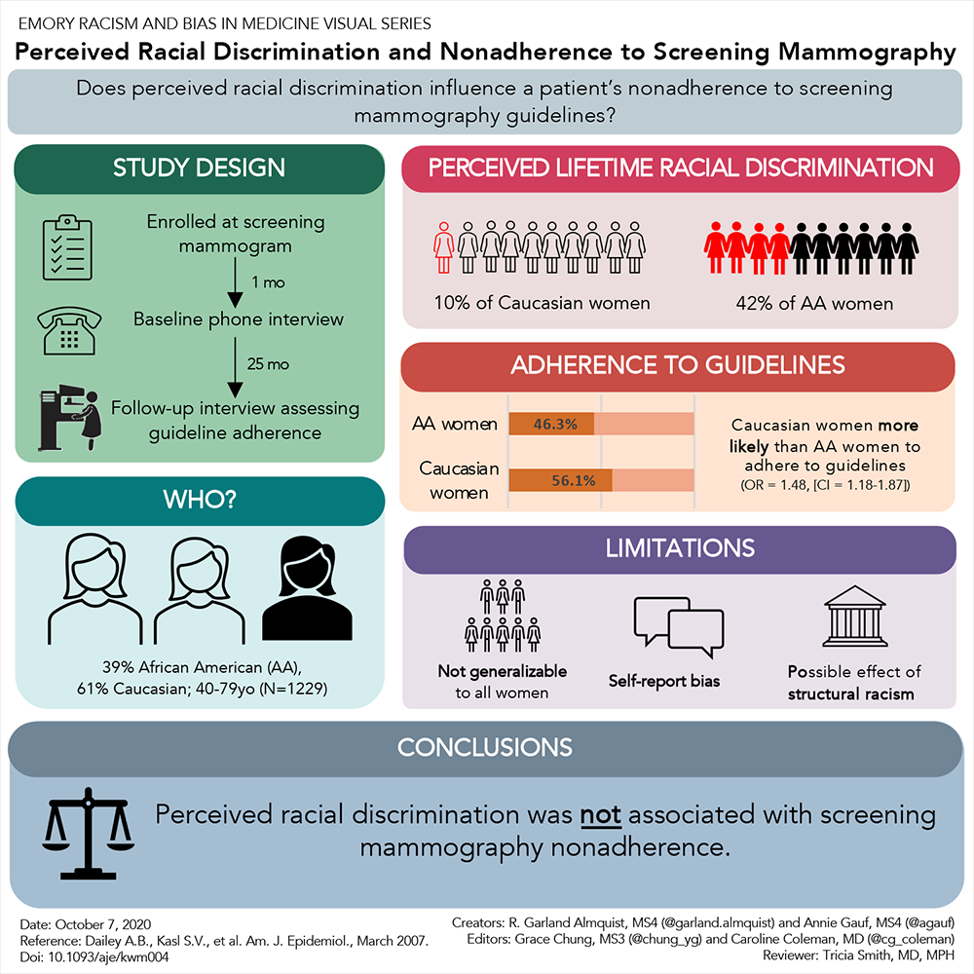
Material strategies for promoting racial diversity in research
Research Environment
Foster an anti-racist research environment
Study team members should be educated on implicit bias
Establish a work culture that values diversity and inclusion
Hire and retain racially diverse research staff
Intentional recruitment
Compensate employees appropriately
Notes:
Research Environment
Sukhera, J., Milne, A., Teunissen, P. W., Lingard, L., & Watling, C. (2018). Adaptive reinventing: Implicit bias and the co-construction of social change. Advances in Health Sciences Education, 23(3), 587–599. https://doi.org/10.1007/s10459-018-9816-3
Stevens, F. G., Plaut, V. C., & Sanchez-Burks, J. (2008). Unlocking the Benefits of Diversity: All-Inclusive Multiculturalism and Positive Organizational Change. The Journal of Applied Behavioral Science, 44(1), 116–133. https://doi.org/10.1177/0021886308314460
Hire and Retain Racially Diverse Staff
Minority Patients Benefit From Having Minority Doctors, But That’s a Hard Match to Make. (n.d.). University of Michigan. Retrieved July 8, 2021, from https://labblog.uofmhealth.org/rounds/minority-patients-benefit-from-having-minority-doctors-but-thats-a-hard-match-to-make-0
How and why to hire a diverse workforce: What you need to know - ProQuest. (n.d.). Retrieved July 13, 2021, from http://www.proquest.com/docview/1950110778?accountid=14816

Slide 13
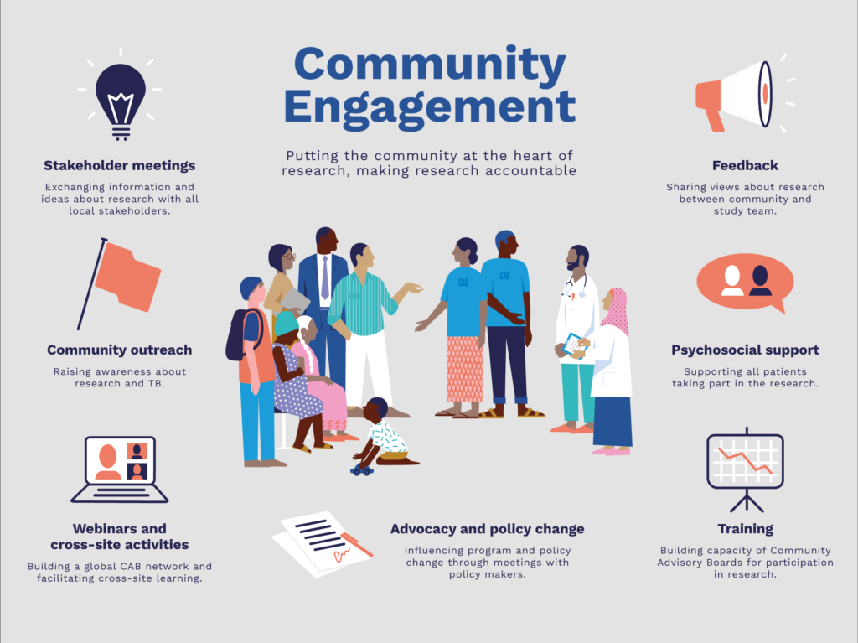
Material strategies for promoting racial diversity in research
Research Procedures
Ensure that the project is culturally tailored and accessible
Study identity and images should be relatable
Health literacy is considered
Earn and build trust with the community
Focus on community engagement and participation
Adjust study design to fit the needs of the priority population
Notes:
Cottrell, L., Harris, C. V., Deskins, S., Bradlyn, A., & Wrye Coffman, J. (2010). Developing Culturally Tailored Health Belief-Based Intervention Materials to Improve Child and Parent Participation in a Cardiovascular Screening Program. Health Promotion Practice, 11(3), 418–427. https://doi.org/10.1177/1524839908321561
Klostermann, B. K., Slap, G. B., Nebrig, D. M., Tivorsak, T. L., & Britto, M. T. (2005, August). Earning trust and losing it: Adolescents’ views on trusting physicians: specific physician behaviors--particularly those implying an assurance of confidentiality--encourage trust-building among adolescents. Journal of Family Practice, 54(8), 679+. Gale Academic OneFile. http://link.gale.com/apps/doc/A135320788/AONE?sid=googleScholar&xid=886dc7b0

Slide 14
Resources
Trial Innovation Network (TIN) toolkit
Diversity in Clinical Trials from Brigham and Women’s Hospital
Engaging Racial And Ethnic Minority Patient Populations in Covid-19 Clinical Trials
The Art of Recruitment
Faster Together – Enhancing Recruitment of Minorities in Clinical Trials

Slide 15
Faster Together, Enhancing the Recruitment of Minorities in Clinical Trials
Sheila Kusnoor, Ph.D.
Center for Knowledge Management
Vanderbilt University Medical Center

Slide 16
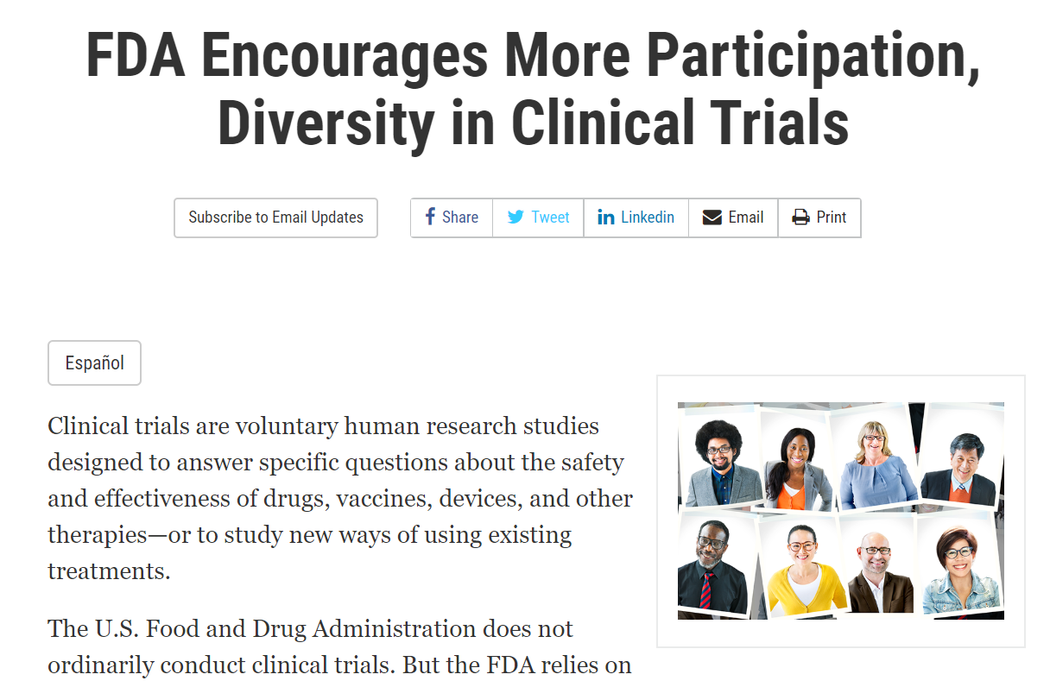
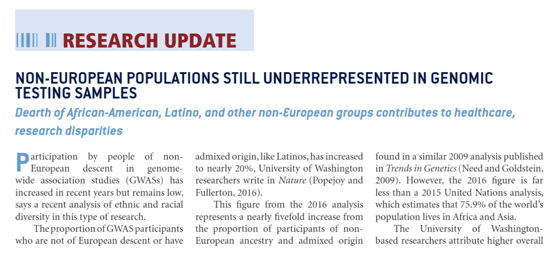
Underrepresented Populations in Research
Hoppe C, Kerr D. Minority underrepresentation in cardiovascular outcome trials for type 2 diabetes. Lancet Diabetes Endocrinol. 2017 Jan;5(1):13.
Loree JM, Anand S, Dasari A, Unger JM, Gothwal A, Ellis LM, Varadhachary G, Kopetz S, Overman MJ, Raghav K. Disparity of Race Reporting and Representation in Clinical Trials Leading to Cancer Drug Approvals From 2008 to 2018. JAMA Oncol. 2019 Aug 15:e191870.
Non-European populations still underrepresented in genomic testing samples: Dearth of African-American, Latino, and other non-European groups contributes to healthcare, research disparities. Am J Med Genet A. 2017 Feb;173(2):296-297.
U.S. Food and Drug Administration. FDA Encourages More Participation, Diversity in Clinical Trials. https://www.fda.gov/consumers/consumer-updates/fda-encourages-more-participation-diversity-clinical-trials

Slide 17
Importance of Diversity in Clinical Trials
Generalizability of findings about safety and efficacy of new treatments

Slide 18
Barriers to Participation of Racial and Ethnic Minorities
Examples:
Distrust of clinicians and researchers
Lack of culturally-appropriate educational materials on clinical trials
Lack of knowledge about clinical trials
Language barriers and lack of translated study materials
Lack of training for researchers and recruiters on the importance of diversity in clinical trials and how to engage underrepresented groups
Ford JG, Howerton MW, Lai GY, Gary TL, Bolen S, Gibbons MC, Tilburt J, Baffi C, Tanpitukpongse TP, Wilson RF, Powe NR, Bass EB. Barriers to recruiting underrepresented populations to cancer clinical trials: a systematic review. Cancer. 2008 Jan 15;112(2):228-42.
Schmotzer GL. Barriers and facilitators to participation of minorities in clinical trials. Ethn Dis. 2012 Spring;22(2):226-30.
Rivers D, August EM, Sehovic I, Lee Green B, Quinn GP. A systematic review of the factors influencing African Americans' participation in cancer clinical trials. Contemp Clin Trials. 2013 Jul;35(2):13-32.
Davis TC, Arnold CL, Mills G, Miele L. A Qualitative Study Exploring Barriers and Facilitators of Enrolling Underrepresented Populations in Clinical Trials and Biobanking. Front Cell Dev Biol. 2019 Apr 30;7:74.
Cunningham-Erves J, Barajas C, Mayo-Gamble TL, McAfee CR, Hull PC, Sanderson M, Canedo J, Beard K, Wilkins CH. Formative research to design a culturally-appropriate cancer clinical trial education program to increase participation of African American and Latino communities. BMC Public Health. 2020 Jun 3;20(1):840.
Niranjan SJ, Durant RW, Wenzel JA, Cook ED, Fouad MN, Vickers SM, Konety BR, Rutland SB, Simoni ZR, Martin MY. Training Needs of Clinical and Research Professionals to Optimize Minority Recruitment and Retention in Cancer Clinical Trials. J Cancer Educ. 2019 Feb;34(1):26-34.

Slide 19
Massive Open Online Course
https://www.coursera.org/learn/recruitment-minorities-clinical-trials
Goal: To teach individuals how to enhance the recruitment of racial and ethnic minorities in clinical trials.
Target audience: Individuals involved in clinical research
Kusnoor SV, Villalta-Gil V, Michaels M, Joosten Y, Israel TL, Epelbaum MI, Lee P, Frakes ET, Cunningham-Erves J, Mayers SA, Stallings SC, Giuse NB, Harris PA, Wilkins CH. Design and implementation of a massive open online course on enhancing the recruitment of minorities in clinical trials - Faster Together. BMC Med Res Methodol. 2021 Mar 5;21(1):44.
National Center for Advancing Translational Sciences, National Institutes of Health (U24TR001579), PIs: Wilkins and Harris

Slide 20
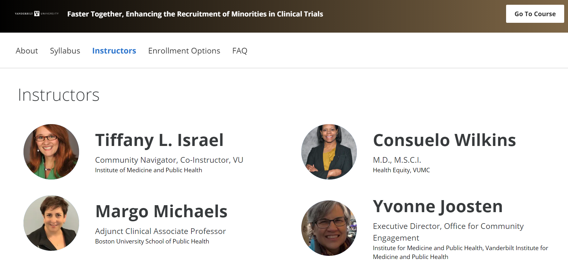
Course Development Team
Content Experts:
Consuelo H. Wilkins, MD, MSCI
Yvonne Joosten, MPH
Tiffany Israel, MSSW
Margo Michaels, MPH
Content Editors:
Center for Knowledge Management
Filming:
Art Magic Labs
Facilitators:
Faster Together Team

Slide 21
Development Process
Develop Syllabus and Draft Content
Filming and Editing
Upload Materials to Coursera
Course Launch
April 1, 2019
Community Advisory Board Feedback and Refinement
Evaluation and Refinement
Literature Review

Slide 22
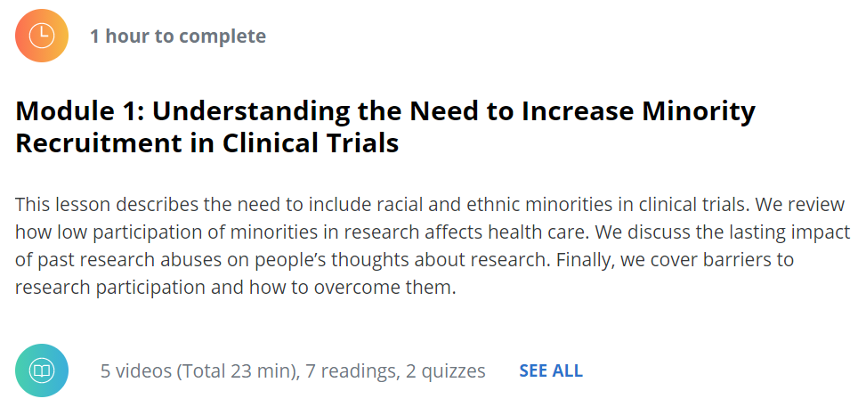
Course Structure
Modules:
Understanding the need to increase minority recruitment in clinical trials
Key principles of community engagement
Reaching out into the community: effective communication
Educating potential research participants
Outreach with community healthcare providers
Effective screening, education, and decision support
Managing an effective, person-centered consent process
Person-centered retention

Slide 23
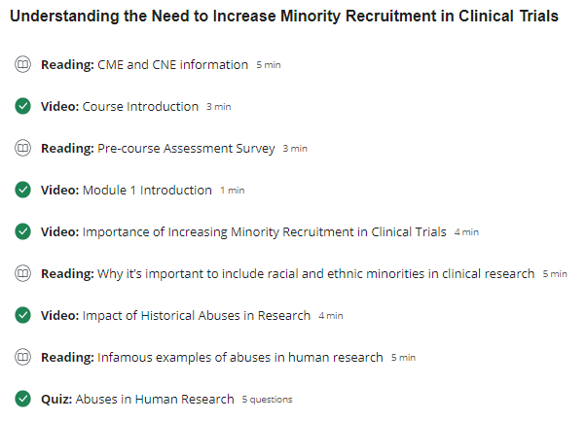
Module Format
Example: Module 1

Slide 24
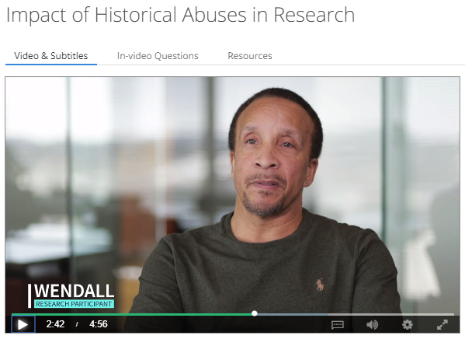
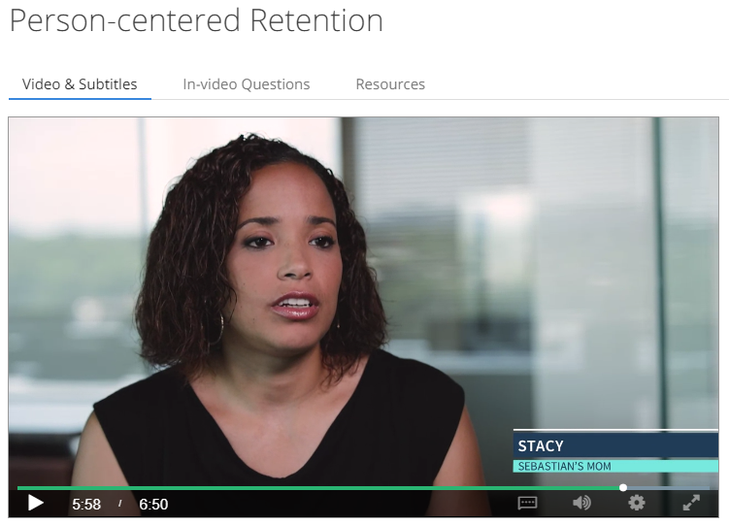
Interviews with Research Participants
“I used to hear horror stories literally from my grandparents, starting with Tuskegee about what happened, and what was done, and wasn’t told to our community. So there has been mistrust for years.”
“I have never heard back from any of the studies my son has been involved in, and…I would love to see what came of it… That’s also another reason why a lot of minorities don’t want to do the studies is because they never hear the results.”

Slide 25
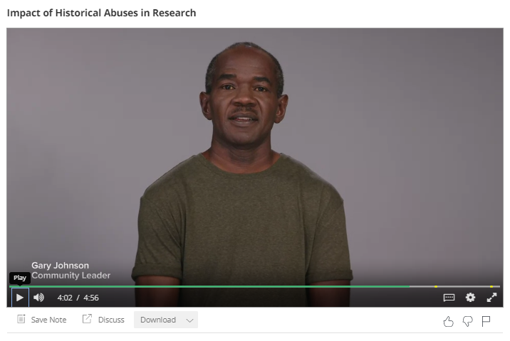
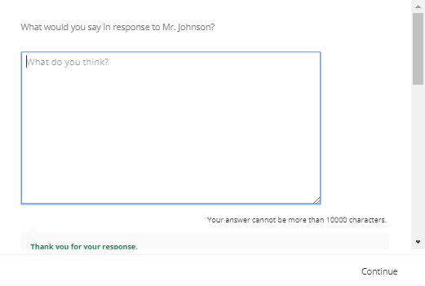
In-video Questions
Mr. Johnson approaches your table and starts to look at your material. You start to ask him about what he’s heard about clinical trials…
“That research might be important for some, but in my community, we are still getting lousy healthcare. Nobody even goes to the doctor, that's the real problem. Even if we participate, it's not going to make one difference in our community.”

Slide 26
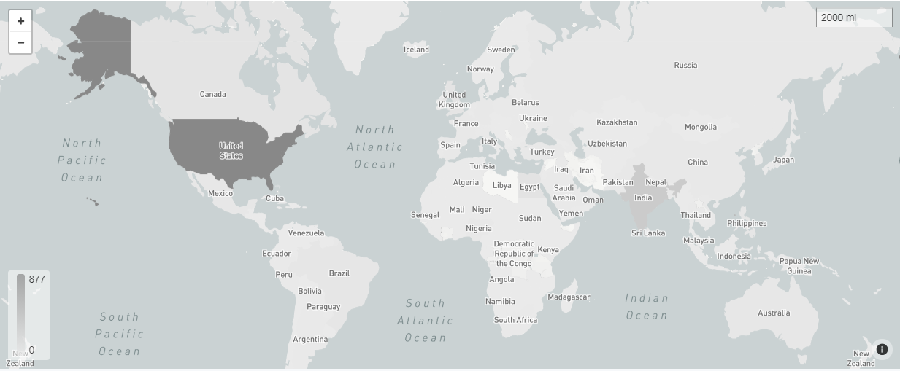
Course Participation
12,269 Unique Visitors
1,936 Enrolled in Course
962 Started Course
302 Completed Course
349 Completed First Half
877
274
Current as of 6/30/2021

Slide 27
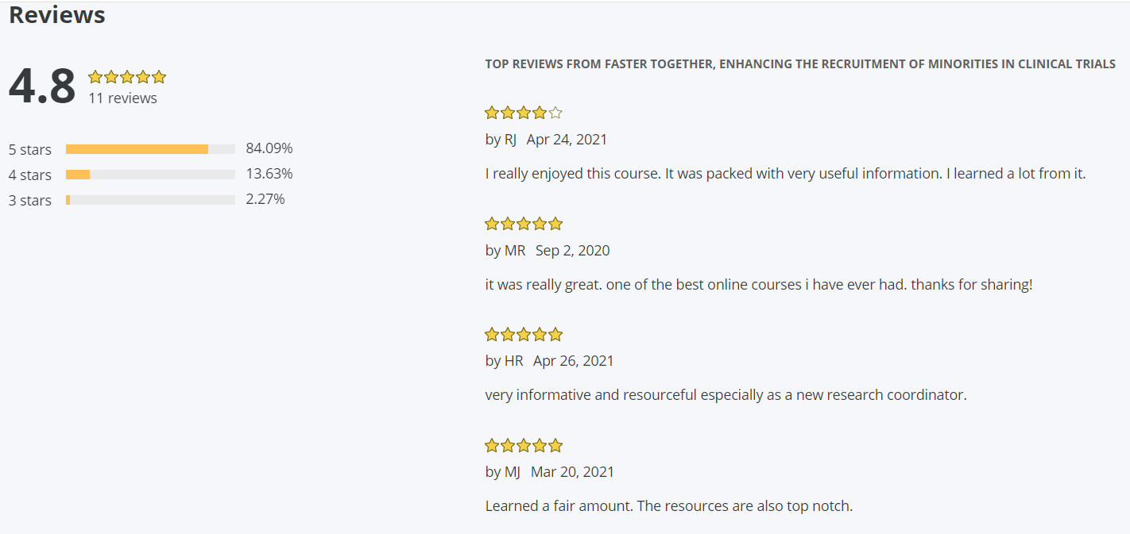
Feedback

Slide 28
Evaluation
As a result of participating in this educational activity, how likely are you to make changes in your clinical trial recruitment and retention practices?
Pre- and post-test study:
Course increased participant knowledge
Participant satisfaction with learning materials and course format
Kusnoor SV, Villalta-Gil V, Michaels M, Joosten Y, Israel TL, Epelbaum MI, Lee P, Frakes ET, Cunningham-Erves J, Mayers SA, Stallings SC, Giuse NB, Harris PA, Wilkins CH. Design and implementation of a massive open online course on enhancing the recruitment of minorities in clinical trials - Faster Together. BMC Med Res Methodol. 2021 Mar 5;21(1):44.

Slide 29
We welcome your feedback

Slide 30
Questions

Slide 31
Next Open Forum
August 19, 2021
Topic: For POCs, By POCs – Conveying the Value-Add of the Trial Innovation Network to Your Research Community: From Roadshows to Newsletters and Testimonials

Slide 32
Links from Chat During the Meeting
https://www.coursera.org/learn/recruitment-minorities-clinical-trials
https://victr.vumc.org/dissemination-of-research-results/
https://trialinnovationnetwork.org/recruitment-retention-tool kit/
https://link.springer.com/content/pdf /10.1186/s12874-021-01240-x.pdf
https://www.bookreporter.com/reviews/the-organ-thieves-the-shocking-story-of-the-first-heart-transplant-in-the-segregated-south
https://rampages.us/studentexp2/unlocking-health-equity/
https://trialinnovationnetwork.org/community-engagement-during-covid-19/?key-element=1604
https://www.cultureshiftteam.com/

