Slide 1
Ensuring quality in clinical trials
Monitoring concepts and CRC development training
Amelia Spinrad, MS 18’ Eunjoo Pacifici, PharmD, PhD Nancy Pire-Smerkanich, DRSc, MS
USC Southern-California Clinical and Translational Sciences Institute
Notes:
Hello everyone and thank you to the TIN forum for having us speak today. We’re excited to share with you a training module that we have just completed that can enable academic research to be properly monitored.
My name is Amelia and I work at University of Southern California’s Clinical and Translational Sciences Institute and the International Center for Regulatory Science. In my current role, I assist with regulatory consultations, conduct regulatory research and develop training modules like the one I am sharing with you today. I previously worked as a clinical research coordinator and am about to finish my masters in regulatory science. I work under the direction of regulatory science faculty who will now briefly introduce themselves starting with Dr. Eunjoo Pacifici.
(Eunjoo)
(Nancy)

Slide 2
Agenda
Definitions and roles
Gaps in training at academic institutions
Monitoring module development
Live demo
Next steps
Discussion
Notes:
Today, I will present our findings that point to gaps in monitoring knowledge and resources at academic institutions and share with you a training module we created to address some of these gaps.

Slide 3
Notes:
Poll Title: How would you best describe yourself? https://www.polleverywhere.com/multiple_choice_polls/vhwcWxdW4l096jL
Before I begin, I would like to gather some general information about you.
Please text the number 37607, SCCTSI. Once you do this, you will receive a message that says you’ve joined. Then you can text in the letter associated with how best you would describe yourself.
If you would like to use the internet, instead of your phone, please go to pollev.com/scctsi
Alright, thank you for sharing I am going to stop this poll and move onto the next question

Slide 4
Notes:
Poll Title: In which of the following types of studies are you involved? https://www.polleverywhere.com/multiple_choice_polls/XziB6BUYoPsqoLd
We would also like to know in which of the following types of studies are you involved.
Thank you for your responses, looks like we have _____

Slide 5
Agenda
Definitions and roles
Gaps in training at academic institutions
Monitoring module development
Live demo
Next steps
Discussion
Notes:
I’m assuming that we have a mixed group of people, those who are somewhat new to the clinical research arena and others who are quite familiar with the subject. In order to get us all on the same page, I am going to start with some basic definitions and roles.

Slide 6
Definition of a clinical trial
NIH
FDA
Interventions
Procedures
Diagnostic strategies
Changes to health-related behaviors
Diet
Exercise
Cognitive therapy
Investigational Products
Drugs
Biologics
Devices
Combination Products
GCP
Notes:
There are different definitions of clinical trials.
For example, the FDA defines a clinical trial as research using human subjects to test an investigational product like a drug or device, while the NIH defines clinical trials more broadly to include not only investigational products but also other interventions like surgical procedures or cognitive therapies.
But regardless, all of them have to follow good clinical practice, or GCP, which is an international standard for the proper conduct of clinical trials.

Slide 7
Stakeholders in clinical trials
Institutional Review Board (IRB)
GCP
Investigator
Sponsor
Notes:
There are three key stakeholders responsible for overseeing the conduct of a clinical trial at the site. All of them must adhere to the GCP guideline.
The institutional review board focuses its efforts on protecting human subjects.
The sponsor initiates a clinical trial and is responsible for its operational and financial aspects.
The investigator is responsible for the conduct of a clinical trial at a site and works directly with the human subjects
But in some trials, the responsibilities of the sponsor and investigator can be intertwined. I will describe this in more detail later.

Slide 8
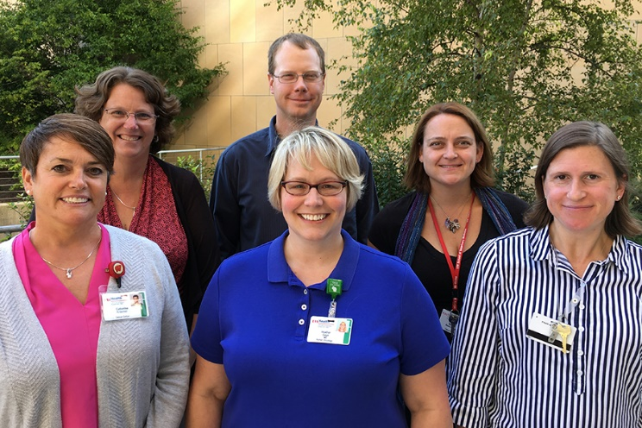
ISTs vs IITs
Industry-Sponsored
Investigator-Initiated
A clinical trial initiated, designed, and overseen by an industry sponsor.
A clinical trial initiated, designed, and overseen by an sponsor-investigator
Pharma
Notes:
There are two different types of clinical trials according to who is considered the sponsor.
Industry-sponsored clinical trials are designed and overseen by an organization like a pharmaceutical company that develops the investigational plan, selects sites and investigators, and manages the legal, regulatory, and financial aspects of the clinical trial. A sponsor may delegate certain responsibilities to other parties, but they are ultimately accountable for ensuring delegated tasks are properly conducted.
Investigator-initiated trials are initiated and overseen by an investigator who is sometimes referred to as a sponsor-investigator. A sponsor-investigator takes the role and assumes the responsibilities of both the investigator and the sponsor. In addition to developing and conducting the clinical trial, a sponsor-investigator also has ensure that the trial meets all regulatory requirements. One such regulatory requirement is following good clinical practice guideline…

Slide 9
Good clinical practice
ADDENDUM | 5.0 Quality Management “The sponsor should implement a system to manage quality throughout all stages of the trial process.”
5.1 Quality Assurance and Quality Control | 5.1.1 “The sponsor is responsible for implementing and maintaining quality assurance and quality control systems with written SOPs to ensure that trials are conducted and data are generated, documented (recorded), and reported in compliance with the protocol, GCP, and the applicable regulatory requirement(s).”
Notes:
The 2016 update to the GCP includes an addendum that strongly emphasizes a need for sponsor’s to implement quality management systems in clinical trials.
Industry-sponsored clinical trials have been utilizing quality management systems for many years. And in industry-sponsored clinical trials you have…

Slide 10
Quality functions in industry-sponsored trials
Clinical Research Coordinators:
Data capturing and recording
Responsible party:
Site
Monitors: Quality control
Responsible party:
Sponsor
Auditors: Quality assurance
Responsible party:
Sponsor
Notes:
The clinical research coordinator who helps to record data from first documentation of the data on source documents to the sponsor via case report forms.
As part of the sponsor’s quality management system, the sponsor monitors and audits the clinical trial sites.
These trials have a monitor who is not part of the clinical research team, but works with the site to ensure human subject protection and data accuracy and validity. Monitors ensure that all of the data that the research coordinator capture is correct by checking the source documents and case report forms.
And sometimes, the sponsor will initiate an audit to ensure that the monitoring function is properly conducted and that the data is correct.
So, generally in industry-sponsored clinical trials, the quality functions are clear, but

Slide 11
Quality functions in investigator-initiated trials
Clinical Research Coordinators:
Data capturing and recording
Responsible party:
Site
Monitors: Quality control
Responsible party:
Sponsor-investigator
?
Auditors: Quality assurance
Responsible party:
Sponsor-investigator
Notes:
The functions are not so clear in investigator-initiated trials.
The sponsor-investigator is responsible for ensuring a proper quality management system, but a lack of institutional resources and funding may hinder the sponsor-investigator from doing so, and there may be little or no monitoring or auditing of an investigator-initiated clinical trial.
And, I would like to know from you…

Slide 12
Notes:
Poll Title: For investigator-initiated trials, do you have someone assigned to perform the monitoring function who is not part of research team for that trial? https://www.polleverywhere.com/multiple_choice_polls/IsAvni3nIF60N8y
Are your investigator-initiated trials monitored by someone who is not a part of the research team for the trial?

Slide 13
Agenda
Definitions and roles
Gaps in training at academic institutions
Monitoring module development
Live demo
Next steps
Discussion
Notes:
We have seen (similar/dissimilar) results in some other polling we have done.

Slide 14
A significant amount of investigator-initiated trials are not monitored
Figure 1: If you work on i-i trials, do you have someone assigned to perform monitoring functions who is not the research coordinator for the trial?
Figure 2: If you work on i-i trials, do you have someone assigned to perform monitoring functions who is not the research coordinator for the trial?
n=60 research professionals (Southern California) 2017
n=23 research professionals (national from ACRP) 2018
Notes:
We find that only about 65% of investigator-initiated trials are monitored in the southern California region and nationally, and this number may be even lower than reported because people may not understand that the monitor must be objective to the study team. Some study teams think they have monitored the data because the research coordinator makes sure its correct and so does the PI, but this really isn’t proper monitoring. There needs to be someone outside of the research team to perform the monitoring quality control function.

Slide 15
GCP trainings do not adequately educate even experienced research professionals on basic monitoring concepts and practical approaches to clinical trial monitoring.
I believe that I would need additional training beyond GCP in order to serve as a monitor.
Level of Monitoring Competency
# of Respondents
Average score of 29%
n=76 research professionals
n=84 research professionals
Notes:
It seems clear that the competencies research professional posses from helping to coordinate clinical trials are different than those associated with monitoring. And, to better understand monitoring concepts, research professionals need additional training.

Slide 16
Agenda
Definitions and roles
Gaps in training at academic institutions
Monitoring module development
Live demo
Next steps
Discussion
Notes:
So, because we saw a clear need for training, we started to develop a monitoring module.

Slide 17
Focus group member suggestions
General Comment | Quotes | Addressed? | How Feedback Was Implemented
More practical case studies & more case studies | “Would be good to have additional case studies and open discussion to real life issues at the sites” “Consider adding more and making them more practical” “Add a few for specific monitor-related cases that could have been prevented with good monitoring” | ✓ ✓ ✓ | Previously, case studies did not include FDA warning letters nor NIMH letters. Now, the module includes 4 FDA warning letters and 1 NIMH letter. Previously, the module contained only 2 case studies. Now, the module has 9 case studies.
Adding a hook and expert monitor interview | “To explain the importance of monitoring?” “Again, to share real-life experience.” | ✓ ✓ | Previously, the module did not contain a hook. Now, an interview with an expert monitor functions as the hook.
Information on clinical trial basics | “More information on clinical trial basics” “Add a section about key stakeholders in CTs” | ✓ ✓ | Created entire chapter called Fundamentals of Clinical Trials
General organization | “Break into sections and chapters” | ✓ | Created sections and chapters
Validity of module | ‘’How do you prove this is valid for training?” | ✓ | In slides added reference on where in GCPs/other published documents
More learning comprehension questions and explanations | “Add more questions and better explanations” | ✓ | Added at least one question to each section and longer explanation.
Certificate | “Will participants receive a certificate for training?” | ✓ | Added mechanism for people who view entire module to receive a certificate
Feedback | “How will users provide feedback?” | ✓ | Added a feedback mechanism on the hosting website
Examples of documents | “Can you make templates for examples of the different documents you refer to that the monitor should check?” | ✓ | Going to link module to CRSO Sharepoint (CHLA/Candice collaboration) which has all of these documents.
Notes:
We convened a focus group with stakeholders from academia, government and industry during the development of the module. When we completed the module we held a user testing group to see if the module was ready to be disseminated.
And, the module we are sharing with you today has addressed all of the comments and suggestions from the focus group and user testing group.

Slide 18
Training for monitoring
CITI GCP: Discussion of monitoring concepts
CITI GCP: Discussion of advanced monitoring concepts
Basic description of some advanced concepts mostly copied and pasted from regulations.
For example, mentions risk-based monitoring, but does not fully describe what it is or how a site could ensure a risk-based approach to monitoring.
CITI GCP: Discussion of Practical Approaches to Monitoring
No discussion of practical approaches to monitoring.
CITI GCP: Case Studies Incorporated Regarding Monitoring
One very basic case study which describes steps that a monitor from a CRO (industry) should take.
Basic description of concepts mostly copied and pasted from regulations
Our Module
In depth description of concepts
Expands on regulations
Our Module
In depth description of concepts
Expands on regulations
Includes case studies on advanced concepts like CAPA and central monitoring
Our Module
Our Module
Practical examples with how to ensure/verify
For example, in-depth descriptions of how monitors can verify data standards (ALCOA+CCEA)
Includes 9 in-depth case studies
Incorporates FDA warning letters into case studies
Incorporates Department of Health & Human Services NIH letter into case studies (for studies that may not be regulated FDA, but are grant funded)
Discusses monitors at academic institutions (pools of CRCs cross-monitoring studies they do not coordinate
Discusses how monitoring could have prevented issues like warning letters, not just monitoring steps
Notes:
You may be curious to know how our module is different than other training programs.
Most academic researchers must undergo CITI training for good clinical practice. On this slide, you can see elements that our module provides beyond CITI training.
For example, we provide a practical approach to monitoring, where we see many other trainings reiterate regulations, not including this how-to piece. And, we also incorporate FDA warning letters into our case studies to provide more real-world scenarios.

Slide 19
Agenda
Definitions and roles
Gaps in training at academic institutions
Monitoring module development
Live demo
Next steps
Discussion
Notes:
Now I am going to show you our module. We believe that this module can be used for a couple different training purposes.
One way is for research coordinator onboarding or development. If research professionals, like coordinators, can understand monitoring concepts, they can better ensure quality in clinical trials they coordinate, even if they are not going to serve as a monitor.
Another way this module can be used is for monitoring training so more senior research professionals could learn how to monitor and cross-monitor studies they do not coordinate. This could provide sponsor-investigators with a way to implement a quality management systems in their clinical trials.

Slide 20
Accessing the module
Go to: https://uscregsci.remote-learner.net/login/index.php
Click create new account (right-hand side)
Type in your information and click Create my new account (bottom of page)
Open your email and click the link to confirm your account
Click courses (middle of page)
Scroll down (a little) and click Module 1 – Clinical Trial Monitoring
Click Enrol me (middle of page) You do not need a password; once you click Enrol me, you will be directed to the module.
Notes:
This module is free, anyone can access it. You are going to be provided with the link in the Webex chat box and these slides so you can access it after this presentation, but for now, I ask that you just follow along.
You go to this website, and for those of you who are new, you click this link, but I am going to click here since I already have a login. Then you click on my courses and clinical trial monitoring.
This module is extensive and that is because this is an important subject for research professionals to understand monitoring. There have even been cases where the FDA has rejected a new drug application because the clinical trials lacked proper monitoring.
That being said, I am going to show all the elements of this training resource. This first section has some information about the module and then you can see our different chapters. We have an introduction, a first chapter on fundamentals, a second chapter discussing monitoring and a third chapter on monitoring plans, visits and reports. Each chapter has an associated quiz. We also have some additional case studies and a summary.
We have a mechanism for providing feedback and we hope that you give us feedback.
Additionally, we provide downloadable templates for monitoring plans and reports and SOPs and checklists for the 4 different types of monitoring visits that occur before during and after a clinical trial.
Finally we provide trainees with a certificate of completion if they review all sections besides chapter one because it may be a little basic for more advanced clinical research professionals and pass all of the quizzes.
And now, I am going to show you one of the sections of this module, I am going to show you this case study, but I am going to open it in a different way because Webex is funny about letting you play audio from a video.

Slide 21
Agenda
Definitions and roles
Gaps in training at academic institutions
Monitoring module development
Live demo
Next steps
Discussion
Notes:
Now that you have seen this training tool, I am going to discuss our future activities.

Slide 22
Future activities
Disseminate
Study dissemination and implementation
Create Module 2 – auditing Module 3 – site readiness for FDA inspections
Continue to explore training gaps
Search for collaborators
Notes:
We are continuing to disseminate this module and will study its dissemination and implementation by following up with some of our users.
We are in the process of developing additional trainings on auditing and FDA inspections and also continuing to explore gaps in training at academic institutions. We are also looking for collaborators in our training initiatives.

Slide 23
Agenda
Definitions and roles
Gaps in training at academic institutions
Monitoring module development
Live demo
Next steps
Discussion
Notes:
And now we will move on to the Q&A section of our presentation.

Slide 24
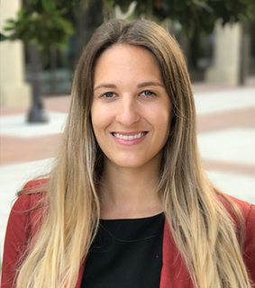
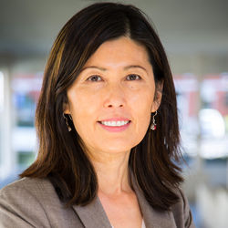
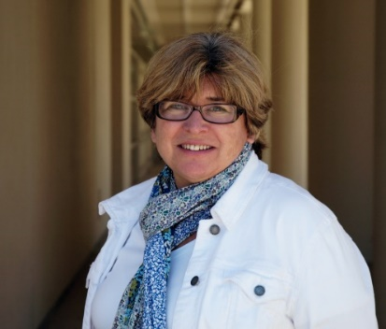
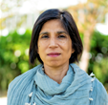
Thank you!
Amelia Spinrad MS ‘18
spinrad@usc.edu
(323) 442-1598
RKS Administrator
Eunjoo Pacifici PharmD, PhD
epacific@usc.edu
(323) 442-1975
RKS Director
Nancy Pire-Smerkanich, DRSc, MS
piresmer@usc.edu (323) 442-4822
RKS Faculty
Apurva Uniyal MA/MS
uniyal@usc.edu (323) 442-6670
DK Kim Center Specialist
RKS = Regulatory Knowledge & Support
USC Regulatory Science | regulatory.usc.edu
SC CTSI | www.sc-ctsi.org
Notes:
Thank you so much for listening.

